Slide 1
Hotel Management System for Krishna Palace
Course Project
FY-MCA
2021-2022
Submitted By:
Batch - 1
Group - 2
Under the
Guidance of:
Roll No. 2 Abhinav Singh
Roll No. 6 Chetan Bagul
Roll No. 10 Shweta Chaudhary
Roll No. 15 Divya Bothra
Mrs. Aparna Sawant
Mrs. Deepali Salapurkar
Web Technology 1

Slide 2
Problem Statement
The project “Hotel Management System” is developed for “Krishna Palace Hotel”. Currently, they don’t have automated system for managing information of hotel. The hotel is using a manual system to handle hotel processes. The problem faced by the hotel is that customers cannot reserve rooms online, user cannot access information about hotel, and others. To solve the above problems our group members developed a web based application to manage the hotel service effectively and efficiently.
Web Technology 2

Slide 3
Contents:
Abstract
Scope of the Project
Objective
Requirements
Use Case Diagram
Diagram
Screen Shots
Conclusion
References
Web Technology 3

Slide 4
Abstract
This web based application is specially developed to manage data/information managed in hotel. The system aims at creating Hotel Management System which can be used by user and admin.
As a security we have provided admin & user level authentication for different modules also the user name and password gets stored in the database in encrypted format more dealing with the security. Admin update rooms, remove rooms, cancel booking, booking history of customers etc. User can book room, check availability of room, room type, cancel booking, make payment, etc.
Web Technology 4

Slide 5
Scope of the Project
The Hotel Management System project is intended for the reservations for room that can be made through online.
This system is designed for the particular need of the client to carry out operations in a smooth and effective manner.
It will make the system more versatile and user friendly.
Hotel Management System can lead to error free, secure, reliable and fast management system.
We have tried my best to make the complicated process of Hotel Management System as simple as possible using Structured & Modular technique & Menu oriented interface.
Web Technology 5

Slide 6
Objectives
To change the manual file handling system in to advanced method of computerized system.
To reserve rooms and other services online.
To access the hotel information.
To solve the time, cost and man power needed to job performance.
To provide efficient service to the new customers.
To solve data redundancy.
To keep data security and reliability.
To need fast data insertion & retrieval.
Web Technology 6

Slide 7
Requirements
Minimum Hardware Requirements:
Computer architecture: Any PC architecture satisfying IBM‘s PC or architecture.
2. Processor Intel Pentium
3. Memory(RAM) : 512 MB
Minimum software requirements:
OS architecture: Microsoft Windows x64 architecture.
2. OS: Windows XP,7,8,10,11
3. Frontend: Java Script, HTML, CSS
4. Server : WAMP Server
5. Backend : PHP, MySQL
6. Database: MySQL
Web Technology 7

Slide 8
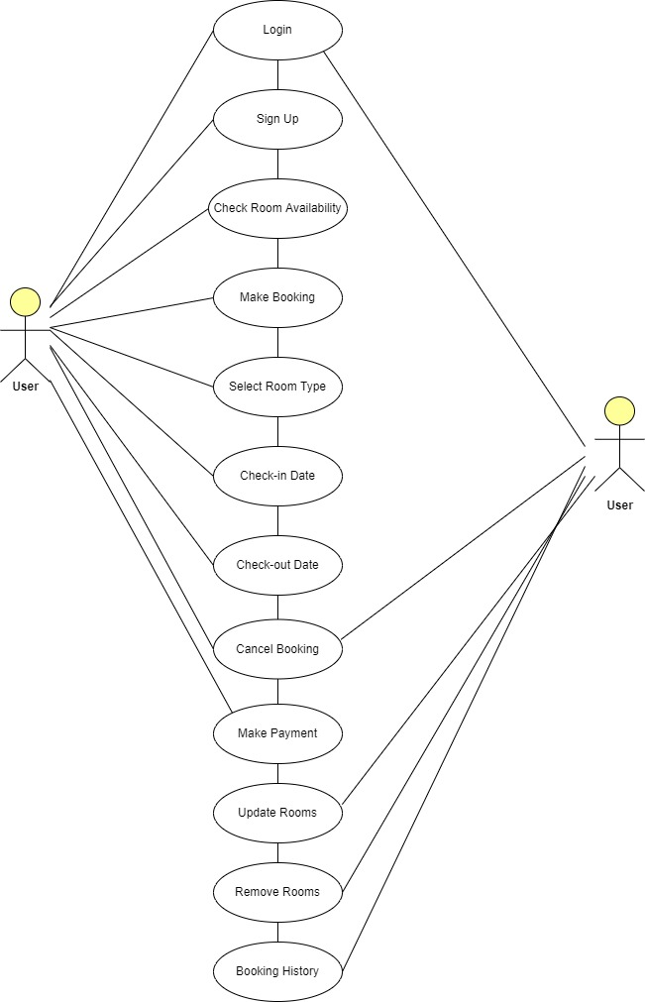
Use Case Diagram
Web Technology 8

Slide 9
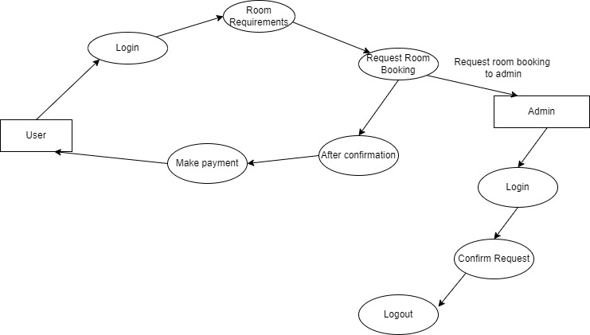
Diagram
Web Technology 9

Slide 10
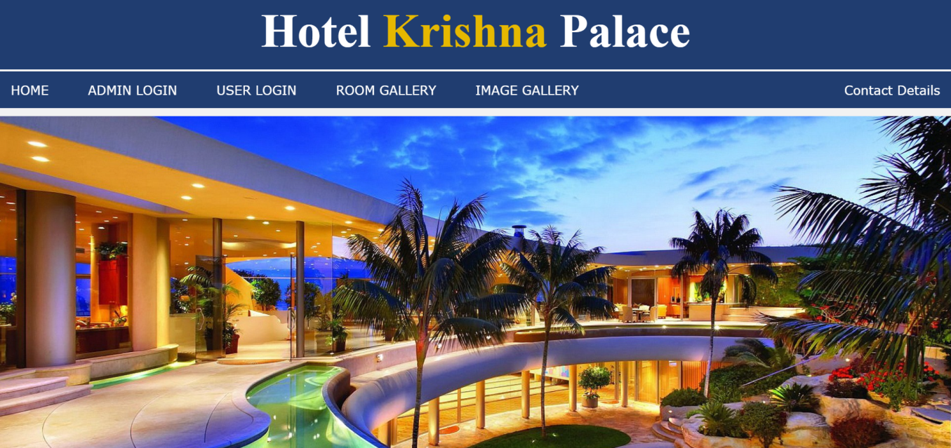
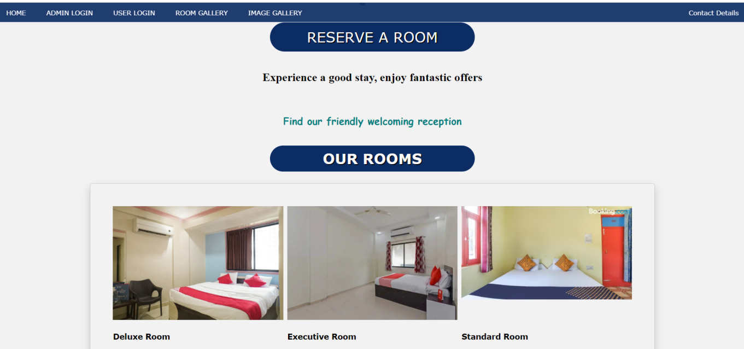
Screen Shots
Web Technology 10

Slide 11
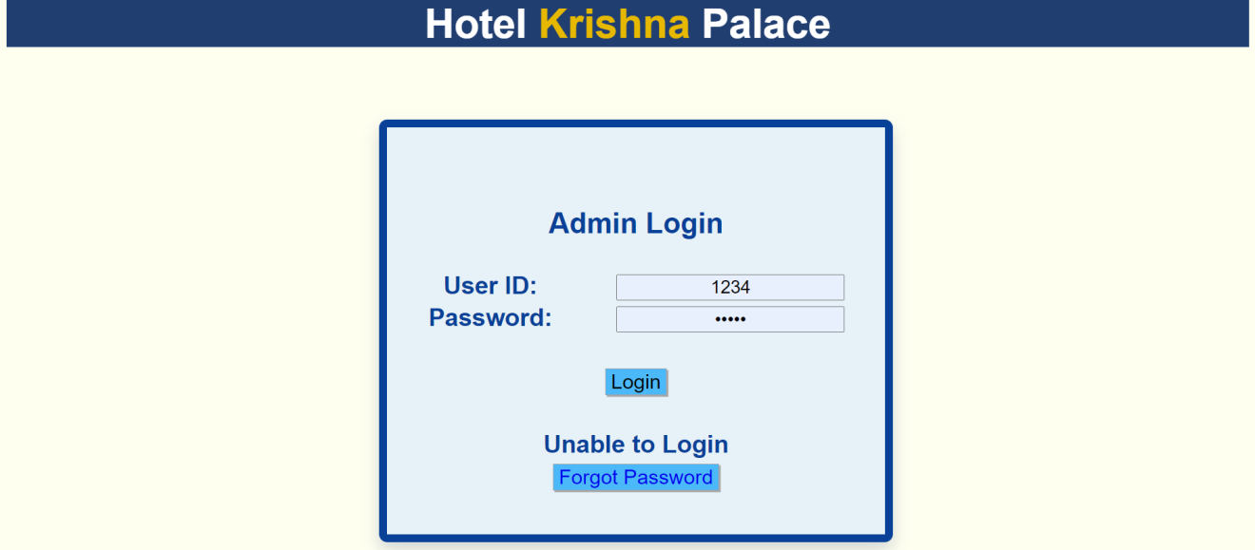
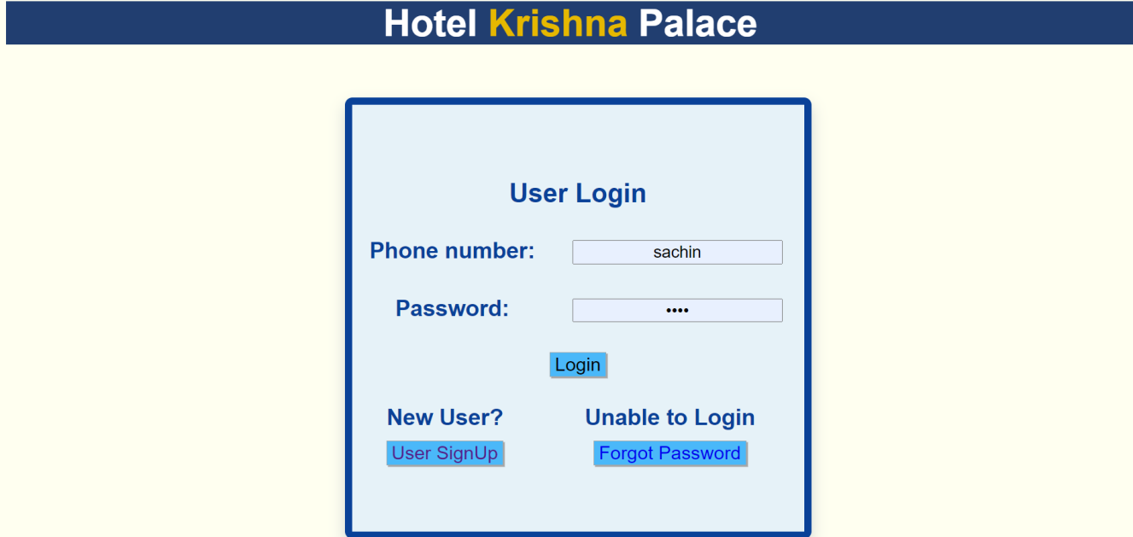
Screen Shots
Web Technology 11

Slide 12
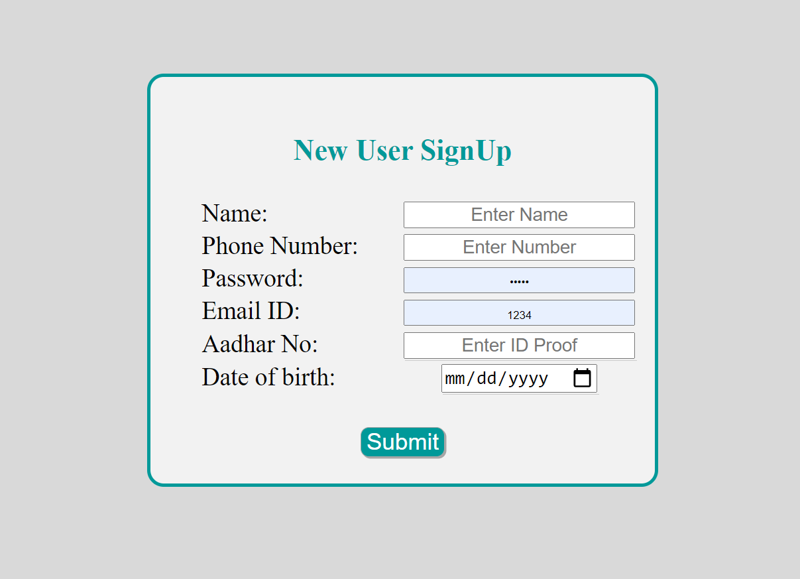
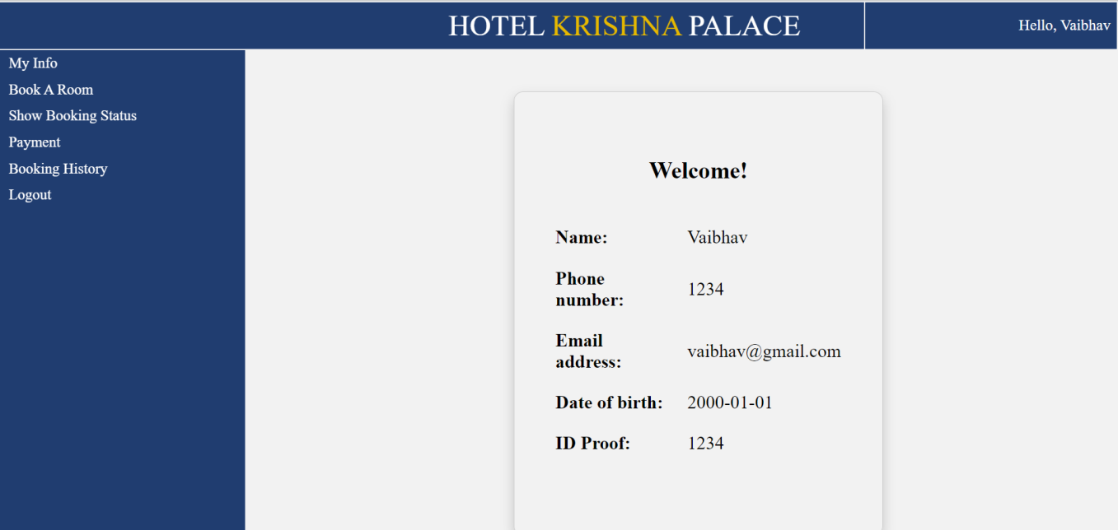
Screen Shots
Web Technology 12

Slide 13
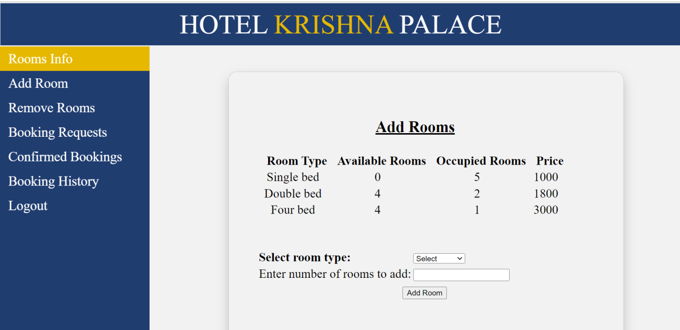

Screen Shots
Web Technology 13

Slide 14
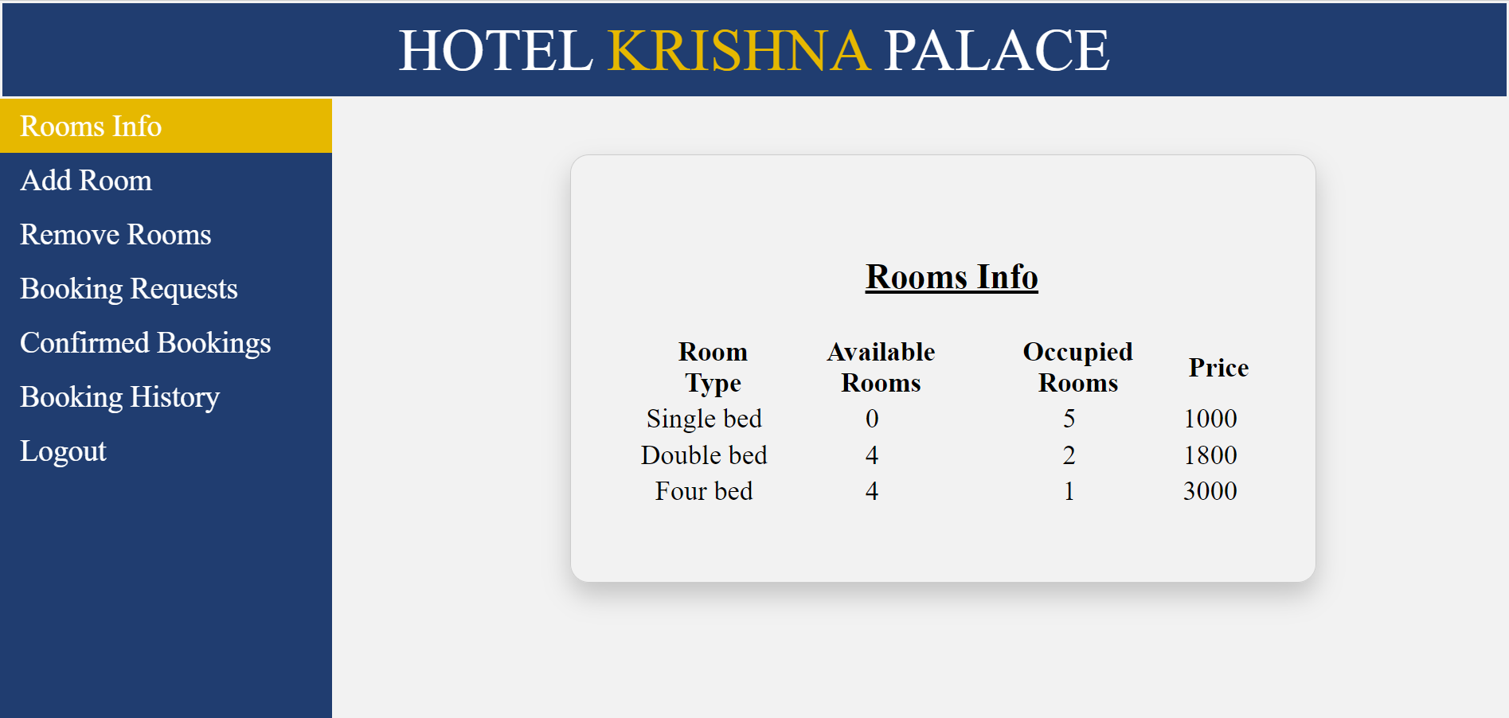
Screen Shots
Web Technology 14

Slide 15
Conclusion
The Hotel Management System project is designed to meet the requirements of client for Krishna Palace Hotel. The entire project has been developed and deployed as per the requirements stated by the client. This project is a computerized management system. The old system does not serve the customer in a better way; rather it makes customer data vulnerable. The new system keeps proper records of customers for emergency and security purposes and enables customers to book room online. We have learnt how to make a system user friendly. During the development process we studied carefully and understood the criteria of Implementation process.
Web Technology 15

Slide 16
References
https://www.w3schools.com/
https://www.tutorialspoint.com/sql/index.htm
https://www.javatpoint.com/sql-tutorial
https://www.w3.org/standards/webdesign/htmlcss
Web Technology 16

